Slide 1

CS 4403 Data Project Propsal
C. Augusto Suarez 3544476
Instructor. Dr. Jong Kyu Kim

Slide 2

Dataset BNG (Heart Statlog)

Slide 3
Dataset Attribute Information: Attributes types: Real: 1,4,5,8,10,12 Ordered:11, Binary: 2,6,9 Nominal:7,3,13 Variable to be predicted: Absence or presence of heart disease

Slide 4
Previous Work Unanimous Voting using Support Vector Machines Overcoming the Myopia of Inductive Learning Algorithms with RELIEFF

Slide 5
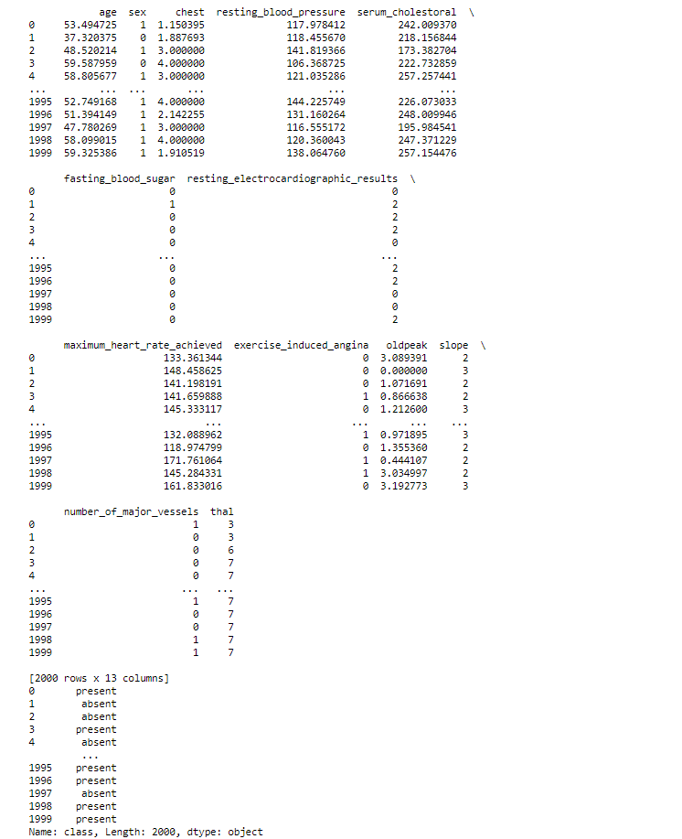
Initial Observations

Slide 6
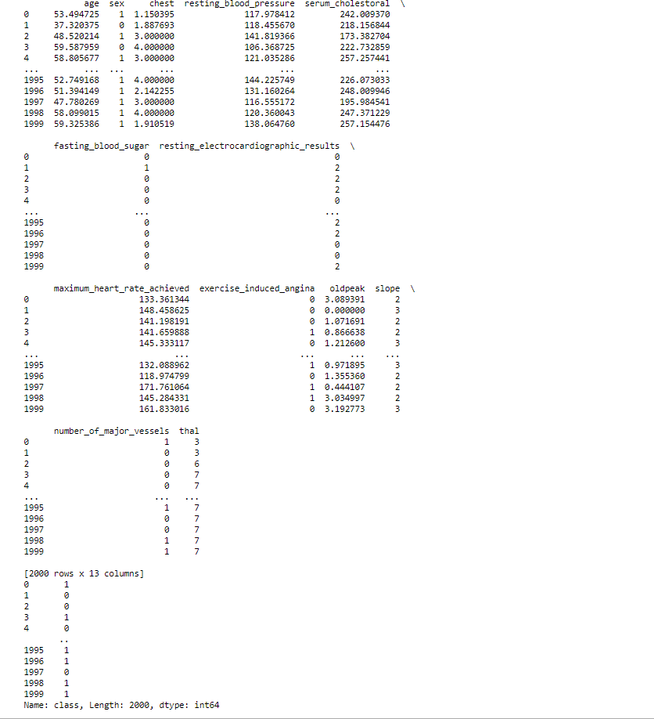
Initial Observations (Nominal Transformation)

Slide 7
Initial Observations (Quick Stats)
Initial Statistics | Mean | Std Dev.
Age | 54.418418 | 82.665292
Sex (More Female) | 0.677211 | 0.218596 (Irrelevant)
Chest | 3.169849 | 0.902509
Resting_blood_pressure | 131.3522 | 318.6361
Serum_cholestoral | 249.5928 | 2673.7352
Fasting_blood_sugar | 0.150919 | 0.128143
Resting_electrocardiographic_results | 1.022207 | 0.988389
Maximum_heart_rate_achieved | 149.6189 | 532.22178
Exercise_induced_angina | 0.333335 | 0.222223
Oldpeak | 1.050869 | 1.306376
Slope | 1.595649 | 0.39594
Number_of_major_vessels | 0.681355 | 0.903507
Thal | 4.709687 | 3.741407
Class (More Absent) | 0.444054 | 0.24687 (Irrelevant)

Slide 8
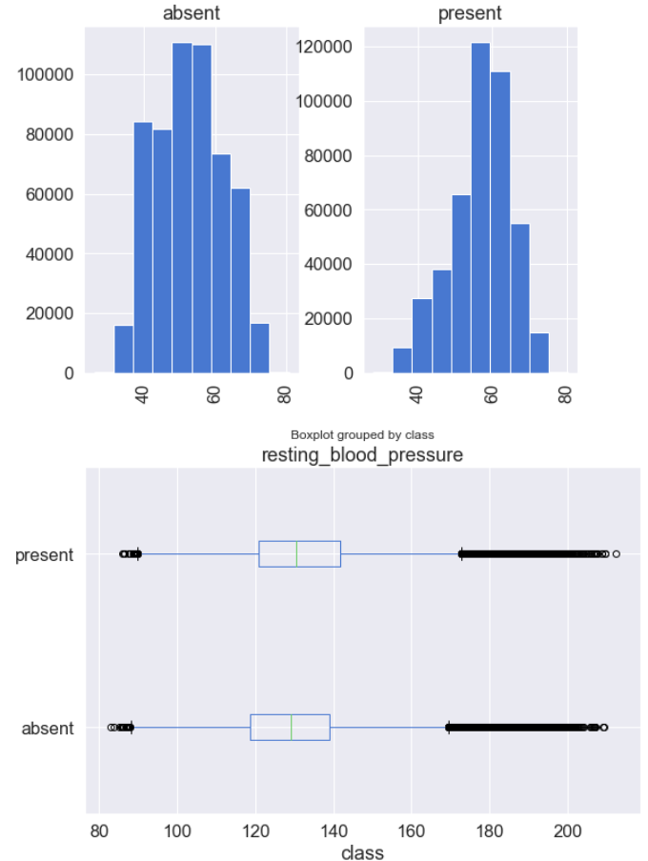
Initial Visualizations (Histogram of Ages by class, boxplot of resting blood pressure by class)

Slide 9
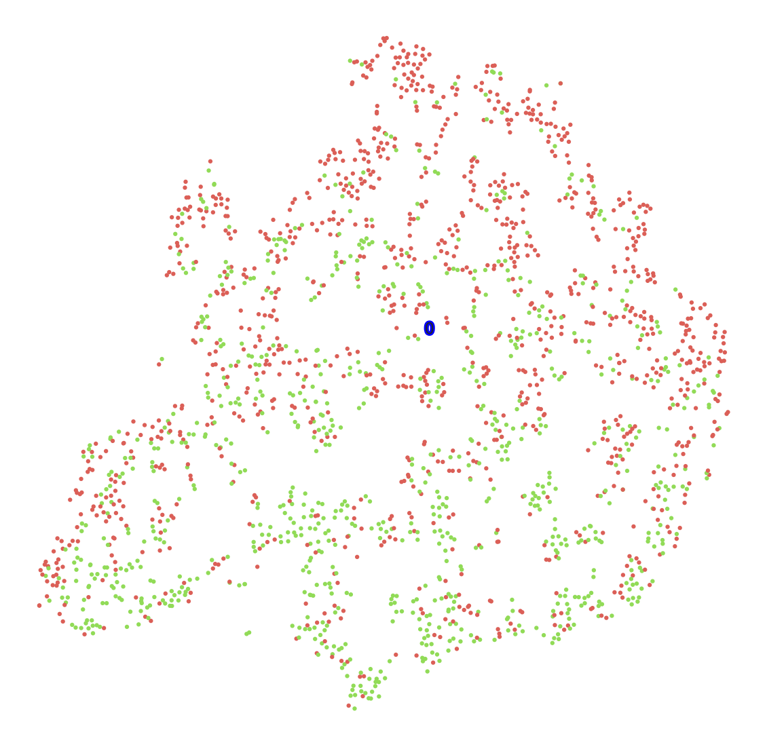
Initial Visualizations (Class separation, no treatment)

